Slide 1
Z-Wave Protocol Based Home Automation and Security System
Roberto Unzaga
Dr Afsaneh Minaie
Utah Valley University
Computer Engineering Program
Spring 2018

Slide 2


Why Home Security?
Home without security is 3x more likely to be broken into
2007, 4 million homes had break-ins and 500,000 resulted in bodily injuries and 20,000 homicides
Growing industry for automation
Notes:
Home Automation has been a growing industry because of IoT and WSN becoming popular; more convenient for users to control and monitor devices in the home with mobile applications.

Slide 3
Machine To Machine
Communication between devices
Growth of 20 to 50 billion devices by 2020
Notes:
Sensors retrieve analog data and send to backend. Temperature, motion, light detection.
Devices and systems can communicate with each other and can be controlled automatically to interact with the household members and improve the quality of their life”

Slide 4

Wireless Sensor Networks
Hospitals
Security
Efficiency
Save Money
Notes:
Monitoring the status of patients in hospitals, control of video and remote sensor security systems, and of building gates and doors. Reduce running costs in modern factories, shops, offices, and residences. Smart buildings can save costs by automatically adjusting heating levels when people leave a room.

Slide 5
WSN Continued
Size
Mobility
Interaction
Topology
Notes:
Each WSN can be completely different depending on the specific needs that are required. For example, deployment might be random or installed at deliberately chosen spots; deployment might be a continuous process or might be a one-time event.
WSN might need to have mobile sensors meaning they can move, be placed on moving objects, or might be an incidental side effect. The reason to choose a WSN is because of the cost, size, and energy of the whole system.
WSNs communicate through a variety of ways such as radio, light, laser, inductive and capacitive coupling, and even sound. Cost, surroundings, and purpose play a key role in which way a WSN communicates. The most common way to communicate is through radio because there doesn’t need to be a line of sight, is implemented with low power consumption and uses small antennas. Light beams require a line of sight and may interfere with ambient light and daylight [6].
A WSN can have different topologies in which they communicate. The two that are the most familiar and most common are the star network and a mesh network. The star network consists of sensor nodes sending their data to a central location. The mesh network has all the sensor nodes capable of receiving data and forwarding that data to another sensor node until it reaches the place it is meant [6].

Slide 6

WSN Risks
Laziness
Security Threats:
Eavesdropping
Denial of Service (DoS)
Node Compromise
Sinkhole/Wormhole
Physical Attack
Notes:
People don’t have backgrounds in coding
Takes time to learn about a system and aren’t willing to learn
Worry that automating the lights reduces opportunities for parents to teach their children how not to be wasteful
Eavesdropping: An outside attack where an attacker can listen in and overhear and take the information.
Denial of service: DoS is when a PC is used to meddle with the frequencies being used by the network in the WSN.
Node Compromise: When a node in the network is taken and compromised or reprogrammed.
Sinkhole and Wormhole Attacks: Sinkhole attack is where there is a fake node that takes the information and creates fake routes for the data to go in and results in the information coming back to that node. Wormhole is when a fake node in the network acts like a regular node but replays the information it has received and gives false information.
Physical Attack: Attacker gains physical access to the device in the network.

Slide 7

Advanced Encryption Standard (AES)
Protects against most attacks
Replaced Data Encryption Standard (DES)
128, 192, 256 key sizes and 128-bit block size
Four Steps:
Substitute bytes
shiftrows,
Mixcolumns
addroundkey

Slide 8
IEEE 802.15.4 (ZigBee)
ZigBee Alliance
Uses 868 MHz, 915 MHz, and 2450 MHz
Mesh or Star Topology
65,000 devices on Network
Uses AES for security
Green Power Initiative
Low-battery consumption
$$
Notes:
65,000 devices might be slower
Green Power Initiative: focusing on power. Batteries are the most toxic waste streams on Earth
Batteries 60 and 1 per month.

Slide 9
Z-Wave
Z-Wave Alliance
450 companies joined, 375 manufacturers and more than 1700 products
908.42 MHz (US)
232 Devices
Mesh Topology
Z-Wave Plus
$$$$
S2, which incorporates AES
Notes:
Z-Wave plus has 50% improved battery life, 67% improved range, 250% more bandwidth, 3 RF channels for noise immunity and a higher bandwidth, and over the air firmware updates.
Z-Wave plus has also been optimized for easy set-up and installation. Z-Wave is fully interoperable but may require physically placing the smart hub near the product being added to the network

Slide 10
Which Z?
ZigBee is cheaper
Z-Wave is more user friendly
Both use AES
Z-Wave is for residential, ZigBee is for Commercial
Z-Wave frequency causes less interference

Slide 11
Design Components
Z-Wave Protocol
Raspberry Pi 3 Model B
Z-Wave Sensors
Raspbian Operating System
Home Assistant
Duck DNS
Jitsi Meet

Slide 12
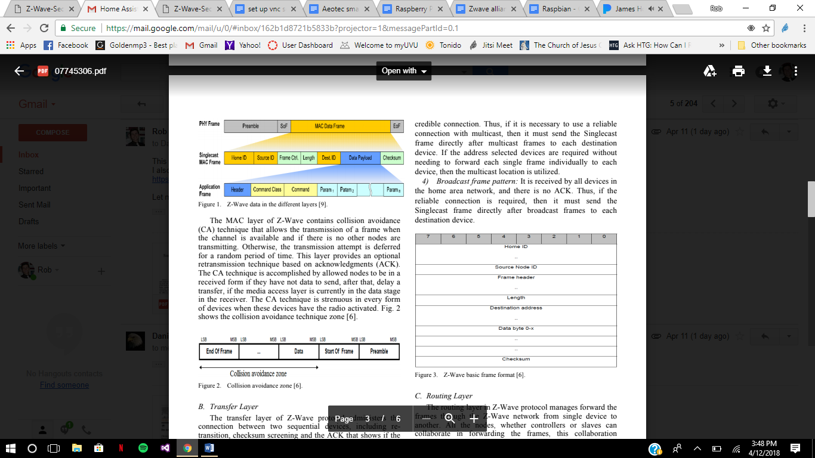
Z-Wave Protocol
232 Devices
Has four layers:
MAC Layer
Transfer Layer
Routing Layer
Application Layer

Slide 13
MAC Layer
Controls Radio Frequency medium
Split data into 8-bit frames
Contains collision avoidance technique
Notes:
lets a node talk to another node or the central hub when the channel is available and not being used by another node. If there is a collision, the transmission attempt is deferred for a random amount of time. The CA is accomplished by having each node that has no data to send to be set to receiving

Slide 14
Transfer Layer
Administers connection between two devices
Retransition
Checksum
Acknowledgement
Notes:
a digit representing the sum of the correct digits in a piece of stored or transmitted digital data, against which later comparisons can be made to detect errors in the data.

Slide 15
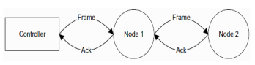
Routing Layer
Forward of frames
Best path to destination with routing table
Routed Singlecast Frame Pattern
Routed Acknowledges Frame Pattern
Notes:
Devices act as repeaters
Routed Singlecast Frame Pattern: a single destination frame with an ACK that gets sent to the parent node. Used to repeat until it either gets to the destination or has 4 hops
Routed Acknowledges Frame Pattern: A routed Singlecast frame without sending an ACK to the parent node

Slide 16
Application Layer
Assigns the command to be done
Decoding
Performing
Every frame form includes an application command except ACK

Slide 17
Connecting Devices
As easy as Bluetooth
Pairing mode
Controller
Home ID
Node ID
Removing

Slide 18
Command Class
Define what info is being passed
Help with programming device
Each device belongs to one or more
Application layer
Controller

Slide 19
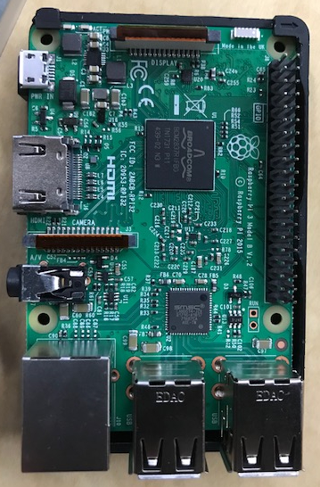
Raspberry Pi 3 Model B
Single Board Computer SoC Broadcom BCM2837 chip
ARM Cortex-A53
Quad core 64 bit processor
1.2 GHZ
Broadcom VideoCore IV
1 GB RAM
10/100 Ethernet
2.4 GHz 802.11n wireless internet LA/N
Bluetooth
microSD
40 GPIO pins
HDMI
4 USB ports
2.5 Amp – 5-volt micro USB port for power
Notes:
Running at 1.2 GHz

Slide 20
Raspbian
Official Operating System of Raspberry Pi
Over 35,000 packages, pre-compiled software
Built for Raspberry Pi
Comes with:
Chromium
Minecraft
Mathematica
Download Process

Slide 21
Virtual Network Computing Server
Graphical desktop sharing system
Uses Remote Frame Buffer protocol
Transmits keyboard and mouse events
Relays graphical screen updates
Over network

Slide 22
Home Assistant
Created by Paulus Schoutsen in 2013
Simple script to turn the lights on when sun was setting
286 different smart devices
Open source software, Python 3
Desktop and mobile client
Connect to USB dongles
Core Architecture is event driven system state machine
Consists of :
States
Events
Automation Rules
Event Stream HTML5 javascript
Venders don’t make devices that connect with Home Assistant: Home Assistant makes it so it connects to all sorts of devices
http://ipaddressofPi:8123

Slide 23
YAML
“Powerful in allowing you to express complex configurations.”
Human friendly data serialization standard
YAML connects the configuration files on the Raspberry Pi to the Home Assistant program
Very particular to indentations and spacing – 2 spaces
Hash tag (#) for comments

Slide 24
YAML, continued
Home Assistant comes with the following files:
Configuration.yaml
Customize.yaml
Groups.yaml
Automations.yaml
Known_devices.yaml

Slide 25
Parts
Z-Wave Z-Stick
Contact Sensor
Motion and Temperature Sensor
Smart Switch
Door Lock
Web Camera
Wireless Speaker

Slide 26
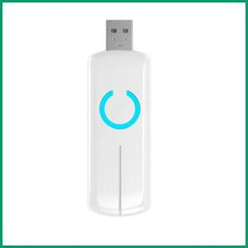
Aeotec Z-Stick Z-Wave Plus Gen5 ZW090-A
Z-Wave Chip
Power supply through USB
Rechargeable lithium battery of 3.7 V
Z-Wave Controller
Sealed

Slide 27
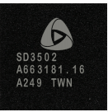
SD3502 General Purpose Z-Wave SoC
Designed by Sigma Designs
Built-in microcontroller
Z-Wave RF transceiver
7mm x 7mm
128kB flash and 16kB SRAM
Backwards compatible for 10 years
MCU
1000 step dimmer
PWM
ADC
23 GPIOs
AES 1288
Notes:
MCU: Microcontroller unit; a computer on a single chip
ADC: Analog-to-Digital Converter

Slide 28
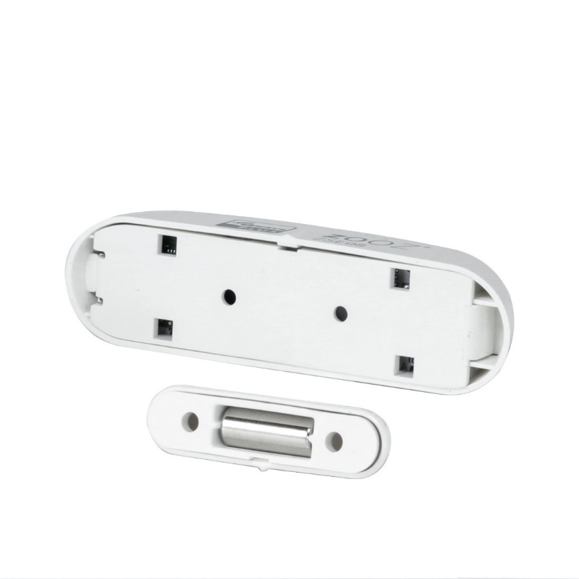
Zooz Z-Wave Plus Contact Sensor ZSE08
CR2 battery
.13 W battery consumption
100 ft radius
2.75 x .75 inches
Z-Wave chip

Slide 29
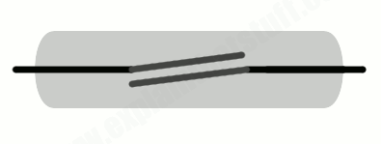
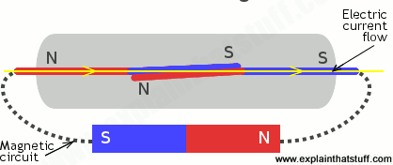
Reed Switch
Ferromagnetic material
Coated with metal
Sometimes plastic casing
Whole switch becomes part of magnetic circuit
Two contacts become opposite magnetic poles

Slide 30
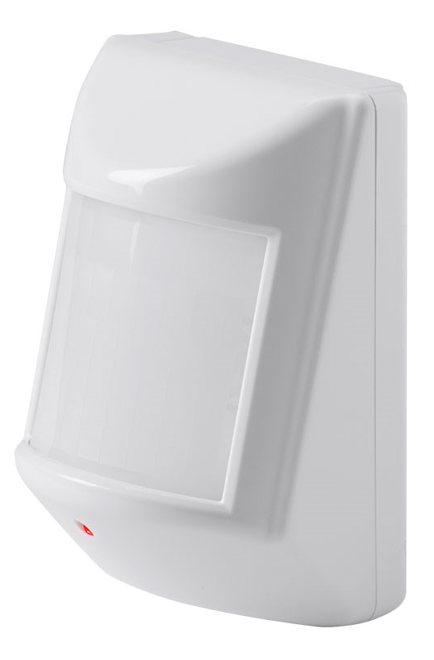
Z-Wave Plus PIR Motion Detector with Temperature Sensor
Passive infrared sensor
32 ft away and 120 degree field of view
Detects changes in temperature
MCP6041 microchip
PIC16F631 microchip

Slide 31
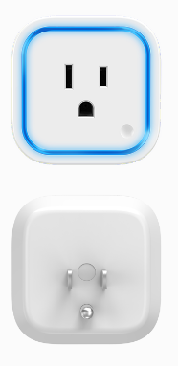
Aeotech Z-Wave Plus Smart Switch 6 Model ZW096-A02
120 V AC, 5 A
5 V, 1 A USB port on side
Range is up to 100 meters
Sealed

Slide 32
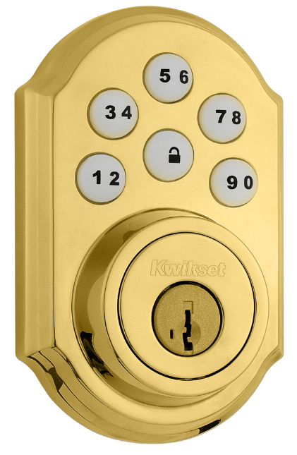
Kwikset Smartcode Door Lock
Back-lit keypad
Easy-to-install
4 AA batteries
Z-Wave Chip on circuit board
Secure Node
Sealed

Slide 33
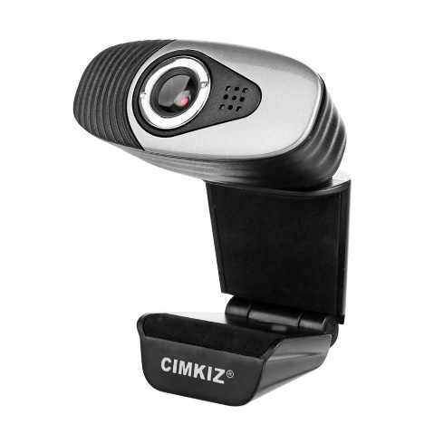
Cimkiz A871 Web Camera
USB cable length 56 in
640 x 480 pixels
30 fps/s

Slide 34
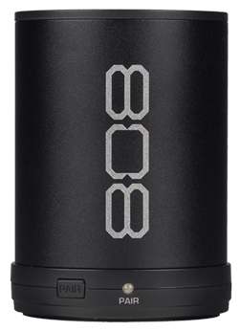
808 CANZ Bluetooth Wireless Speaker SP880
Aux-in Jack uses 3.5mm cable
Li-Ion Rechargeable Battery - 6 hours of playback
Micro USB port

Slide 35

Away From Home
Port Forwarding
Domain Name System
Secure Sockets Layer
Notes:
Duck DNS: Dynamic DNS service; subdomain
SSL is standard security technology for establishing encrypted link between a web server and a browser and ensures that all data passed between the web server and browsers remain private and integral.

Slide 36
Jitsi Meet
Videoconferencing online
Passes everyone’s video and audio
Java
Secure encryption
Password protection

Slide 37
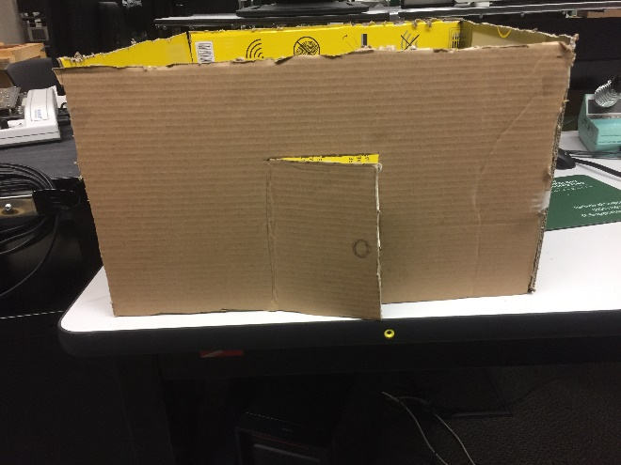
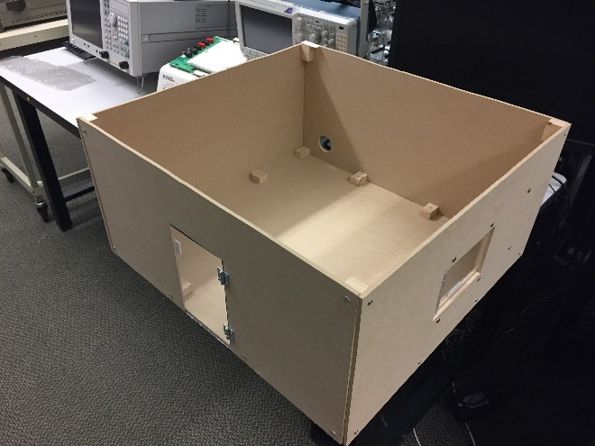
Home Model
Built to visualize what is going on
Uses Command Tabs to place sensors

Slide 38
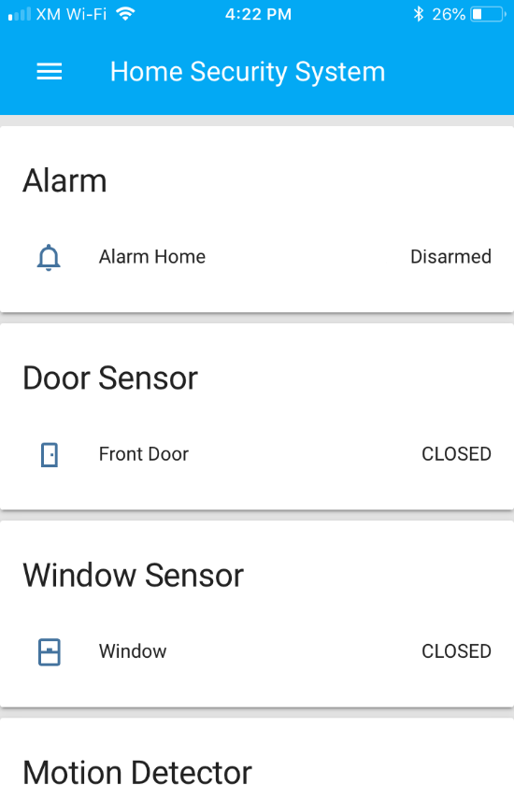
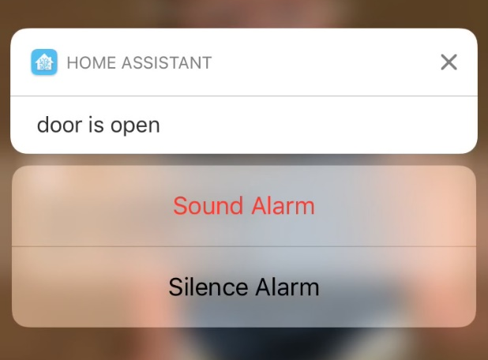
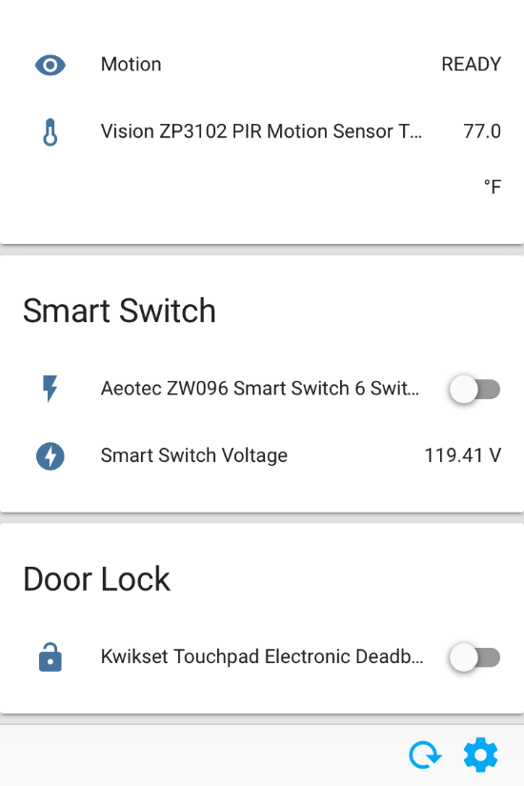
Final View
Alarm
Door Sensor
Window Sensor
Motion Detector
Smart Switch
Door Lock

Slide 39
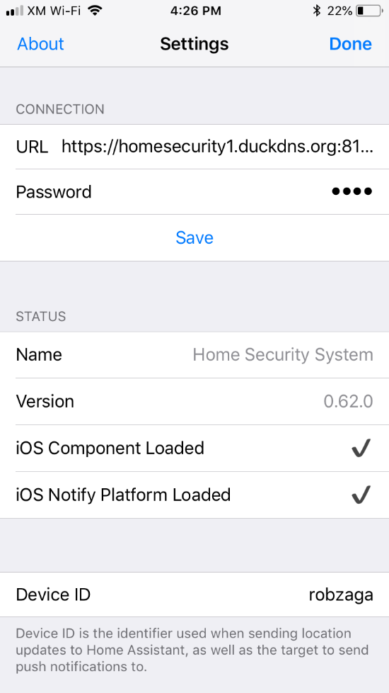
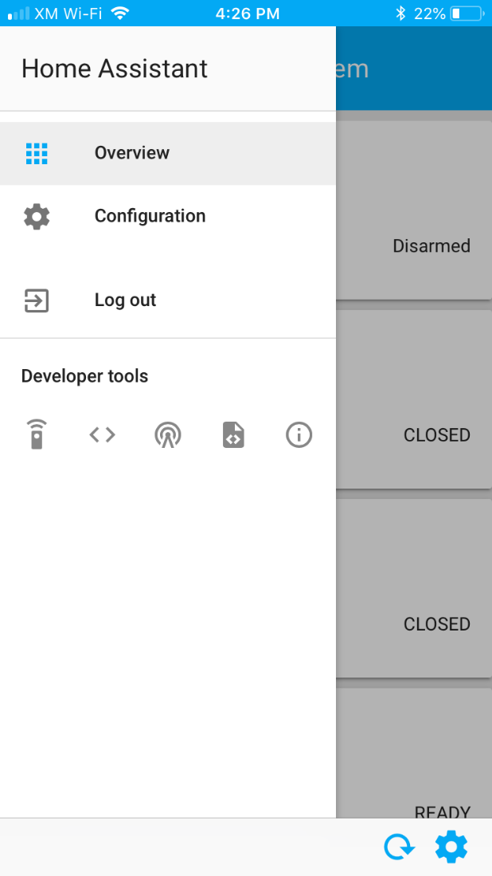
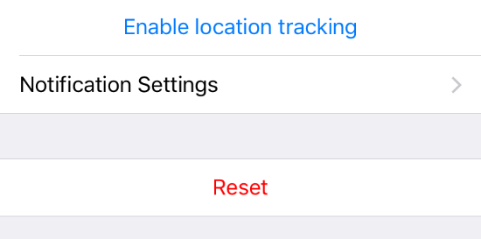
Home Assistant Settings
URL
Password
Notification settings
Configuration
Developer Tools:
Calling Services
State of Devices
Events
Templates
Detail
Notes:
. The first tool is used for calling services. An example of this would be to turn off the Home Assistant or restart it. The second tool is used for the states of the devices and sets the representation of an entity. The third tool is for Events and fires events. The fourth tool is templates and renders templates. The previous two tools weren’t used much at all. The first two tools were used quite often. The fifth and final tool is info and has detail about the Home Assistant.

Slide 40
Code Explanation
----configuration.yaml----
homeassistant:
name: Home Security System
unit_system: imperial
time_zone: America/Denver
customize: !include customize.yaml
group: !include groups.yaml
automation: !include automations.yaml

Slide 41
sensor:
- platform: template
sensors:
front_door:
friendly_name: Front Door
entity_id:
- binary_sensor.zooz_zse08_contact_sensor_sensor
value_template: >-
{%- if is_state(“binary_sensor.zooz_zse08_contact_sensor_sensor”, “on”) -%}
OPEN
{%- else -%}
CLOSED
{%- endif -%}
icon_template: >-
{%- if is_state(“binary_sensor.zooz_zse08_contact_sensor_sensor”, “on”) -%}
mdi:door-open
{%- else -%}
mdi:door-closed
{%- endif -%}

Slide 42
window:
friendly_name: Window
entity_id:
- binary_sensor.zooz_zse08_contact_sensor_sensor_3
value_template: >-
{%- if is_state("binary_sensor.zooz_zse08_contact_sensor_sensor_3", "on") -%}
OPEN
{%- else -%}
CLOSED
{%- endif -%}
icon_template: >
{% if is_state('binary_sensor.zooz_zse08_contact_sensor_sensor_3', 'on') %}
mdi:mdi:window-open
{% else %}
mdi:mdi:window-closed
{% endif %}
motion:
friendly_name: Motion
entity_id:
- sensor.vision_zp3102_pir_motion_sensor_burglar
value_template: >-
{%- if is_state("sensor.vision_zp3102_pir_motion_sensor_burglar", "8") -%}
DETECTED
{%- else -%}
READY
{%- endif -%}

Slide 43
alarm_control_panel:
- platform: manual
name: Alarm Home
code: 1111
pending_time: 0
trigger_time: 0
armed_away:
trigger_time: 0
pending_time: 15
armed_home:
pending_time: 0
trigger_time: 0
frontend:
themes:
day:
primary-color: yellow
night:
primary-color: blue
config:
http:
base_url: https://URL:8123
api_password: password
ssl_certificate: location of the certificate
ssl_key: location of the certificate
zwave:
usb_path: /dev/ttyACM0
network_key: “0x00, 0x00, 0x00, 0x00, 0x00, 0x00, 0x00, 0x00, 0x00, 0x00, 0x00, 0x00, 0x00, 0x00, 0x00, 0x00”
discovery:
ignore:
- roku
- samsung_tv
- netgear_router
- apple_tv

Slide 44
ios:
push:
categories:
- name: pushbuttons
identifier: 'pushbuttons'
actions:
- identifier: 'IGNORE'
title: 'Ignore'
activationMode: ‘foreground’
authenticationRequired: yes
- identifier: 'SOUNDALARM'
title: 'Sound the Alarm!'
activationMode: ‘foreground’
authenticationRequired: yes
notify:
- name: Rob_Alert
platform: smtp
server: smtp.gmail.com
port: 587
sender: rob.bunzaga@gmail.com
starttls: 1
username: rob.bunzaga@gmail.com
password: RobDanielUA
recipient: rob.bunzaga@gmail.com

Slide 45
----customize.yaml----
binary_sensor.zooz_zse08_contact_sensor_sensor:
friendly_name: Door Sensor
binary_sensor.zooz_zse08_contact_sensor_sensor_3:
friendly_name: Window Sensor
sensor.front_door:
icon: mdi:door
sensor.window:
icon: mdi:mdi:window-closed
sensor.aeotec_zw096_smart_switch_6_voltage:
icon: mdi:flash-circle
friendly_name: Smart Switch Voltage
default_view:
view: yes
icon: mdi:home
entities:
- group.Alarm
- group.Door
- group.Window
- group.Motion
- group.SmartSwitch
- group.DoorLock

Slide 46
Alarm:
name: Alarm
entities:
- alarm_control_panel.alarm_home
Door:
name: Door Sensor
entities:
- sensor.front_door
Window:
name: Window Sensor
entities:
- sensor.window
DoorLock:
name: Door Lock
entities:
- lock.kwikset_touchpad_electronic_deadbolt_locked
SmartSwitch:
name: Smart Switch
entities:
- switch.aeotec_zw096_smart_switch_6_switch
- sensor.aeotec_zw096_smart_switch_6_voltage
Motion:
name: Motion Detector
entities:
- sensor.motion
- sensor.vision_zp3102_pir_motion_sensor_temperature

Slide 47
----automations.yaml----
- id: action_push_message
alias: Door armed home notification
initial_state: 'on'
trigger:
- entity_id: sensor.front_door
from: CLOSED
platform: state
to: OPEN
action:
- data:
data:
action_data:
entity_id: sensor.front_door
push:
badge: 0
category: pushbuttons
message: door is open, armed stay
service: notify.ios_daniels_iphone
- data:
message: door is open. Armed Stay
service: notify.dan_alert
- data:
data:
action_data:
entity_id: sensor.front_door
push:
badge: 0
category: pushbuttons
message: door is open, armed stay
service: notify.ios_robzaga
condition:
- condition: state
entity_id: alarm_control_panel.alarm_home
state: armed_home
- id: push_notify_action
alias: 'Push Notify Action'
initial_state: 'on'
trigger:
- platform: event
event_type: ios.notification_action_fired
event_data:
actionName: IGNORE
action:
service: homeassistant.restart
- id: push_notify_action_two
alias: 'Push Notify Action Two'
initial_state: 'on'
trigger:
- platform: event
event_type: ios.notification_action_fired
event_data:
actionName: SOUNDALARM
action:
service: homeassistant.restart

Slide 48
- data:
data:
action_data:
entity_id: sensor.window
push:
badge: 0
category: pushbuttons
message: window is open, armed away
service: notify.ios_daniels_iphone
- data:
message: window is open, Armed away
service: notify.dan_alert
- data:
data:
action_data:
entity_id: sensor.window
push:
badge: 0
category: pushbuttons
message: window is open, armed away
service: notify.ios_robzaga
alias: Window armed away notification
condition:
- condition: state
entity_id: alarm_control_panel.alarm_home
state: armed_away
trigger:
- entity_id: sensor.window
from: CLOSED
platform: state
to: OPEN
- action:
- data:
data:
action_data:
entity_id: sensor.front_door
push:
badge: 0
category: pushbuttons
message: door is open, armed away
service: notify.ios_daniels_iphone
- data:
message: door is open. Armed away
service: notify.dan_alert
- data:
data:
action_data:
entity_id: sensor.front_door
push:
badge: 0
category: pushbuttons
message: door is open
service: notify.ios_robzaga
alias: Door armed away notification
condition:
- condition: state
entity_id: alarm_control_panel.alarm_home
state: armed_away
trigger:
- entity_id: sensor.front_door
from: CLOSED
platform: state
to: OPEN

Slide 49
- action:
- data:
data:
action_data:
entity_id: sensor.motion
push:
badge: 0
category: pushbuttons
message: Motion was detected. Armed away
service: notify.ios_daniels_iphone
- data:
message: Motion is detected. Armed Away
service: notify.dan_alert
- data:
data:
action_data:
entity_id: sensor.motion
push:
badge: 0
category: pushbuttons
message: Motion was detected. Armed away
service: notify.ios_robzaga
alias: Motion armed away notification
condition:
- condition: state
entity_id: alarm_control_panel.alarm_home
state: armed_away
trigger:
- entity_id: sensor.vision_zp3102_pir_motion_sensor_burglar
from: '0'
platform: state
to: '8'
- action:
- data:
data:
action_data:
entity_id: sensor.window
push:
badge: 0
category: pushbuttons
message: window is open, armed_home
service: notify.ios_daniels_iphone
- data:
message: window is open. Armed home
service: notify.dan_alert
- data:
data:
action_data:
entity_id: sensor.window
push:
badge: 0
category: pushbuttons
message: window is open, armed_home
service: notify.ios_robzaga
alias: Window armed_home notification
condition:
- condition: state
entity_id: alarm_control_panel.alarm_home
state: armed_home
trigger:
- entity_id: sensor.window
from: CLOSED
platform: state
to: OPEN

Slide 50
----known_devices.yaml----
robzaga:
hide_if_away: false
name: robzaga
track: true
daniels_iphone:
name: daniels_iphone
track: true

Slide 51
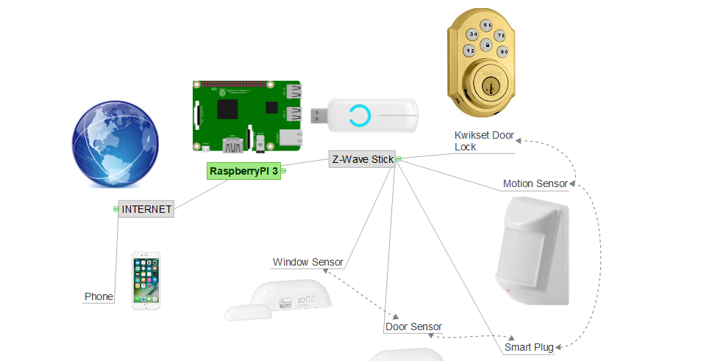
Schematic of Wireless Devices

Slide 52
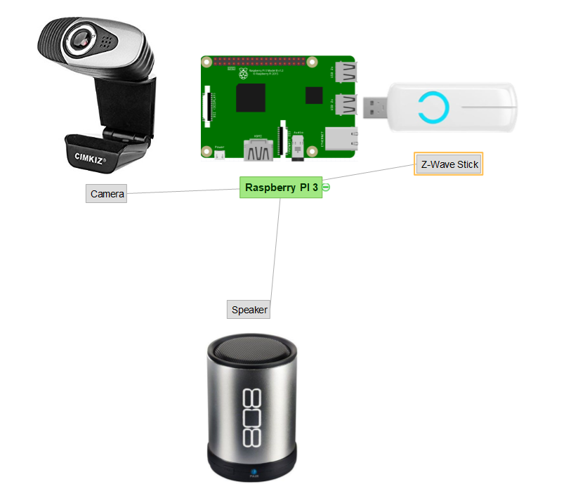
Schematic of Wired Devices

Slide 53
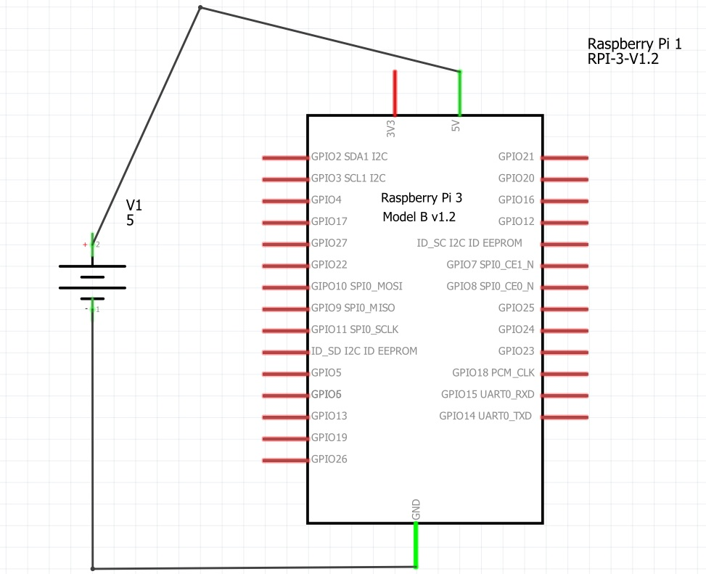
Circuit Design of Raspberry Pi

Slide 54
Device | Cost | Paid
Canz 808 bluetooth speaker | $19.99 | $0
Brass Z-wave Kwikset Door lock | $100 - $200 | $0
Raspberry Pi with Protective Case | $69.99 | $69.99
Aeotec Smart Switch 6, remote control z-wave plus smart plug | $49.99 | $49.99
2 Zooz Z-wave plus D/W contact Sensors ZSE08 | $19.95 | $39.90
Monoprice Z-wave plus PIR Motion detector | $24.99 | $24.99
Cimkiz A871 USB Webcam with built in MIC | $11.85 | $11.85
Aeotec Z-stick Gen 5, Z-wave plus USB to create gateway | $44.65 | $44.65
Wood and accessories for model home | $30 | $30
Total | $397 - $497 | $271.37
Notes:
201 hours spent on project

Slide 55

Project Constraints
Recording Video
Making sensors
Sealed devices
Home Assistant
Camera connected to Main App
Power
Money
Price of Sensors and System
Battery life
Distance to Raspberry Pi

Slide 56
Problems Encountered/What was Learned
Problems with Raspberry Pi VNC
Door Lock connecting to Z-Wave controller
Notifications/push notifications
Accessing Home Assistant away from home

Slide 57
Conclusions/Recommendations
Better than what was expected
Consider making an app
Great success

Slide 58
Future Work
Store video to an external hard drive for video playback
Make sensors
Make Video camera(s) more secure and outside
Making web application and mobile application.

Slide 59
Demonstration

Slide 60
Questions

